Slide 1

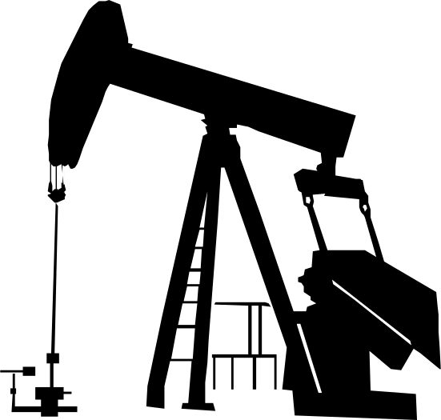
Oil
Pumpjack

Slide 2


Table of Contents & Contribution
01. Introduction
02. Optimisation of Pumpjack
03. Kinematic & Dynamic Analysis
04. simulation and summary
ME22B1034(1-4)
ME22B1009 (5-8)
ME22B1043 (ppt + 9-13)
ME22B1015 (13 - 15)

Slide 3

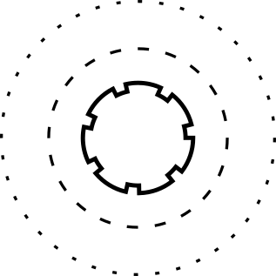
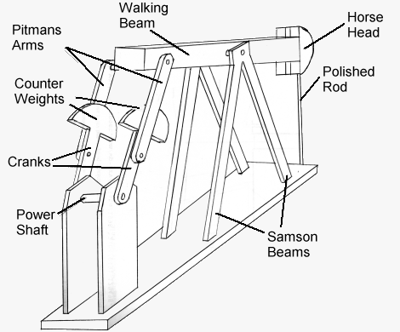
Introduction
A simple pump jack mechanism consists of a walking beam, horsehead, sucker rods, an engine, crank, Samson post.
The walking beam is driven by a motor through a crank mechanism, and it is connected to the horsehead, which in turn is connected to the sucker rods that pump oil from the well.

Slide 4

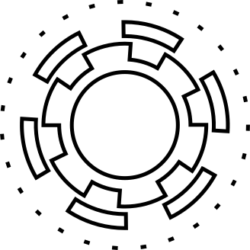
Nomenclature:
Samson Post: This is the structure that supports the top of the pumpjack. It houses the motor, gearbox, and other mechanical components.
Motor: Typically an electric motor, it provides the power needed to operate the pumpjack system.
Gearbox: The gearbox converts the rotary motion of the motor into the reciprocating motion required to operate the pump.
Counterweights: These are attached to the opposite end of the pumpjack from the horsehead. These help balance the system and reduce the load on the motor during operation.
Walking Beam: A large pivoting beam that converts the rotary motion from the motor into the reciprocating motion needed to operate the pump. It's connected to the gearbox and counterweights.
Pitman Arms: These linkages connect the walking beam to the downhole pump. They transmit the reciprocating motion from the walking beam to the pump.

Slide 5
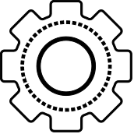
Optimization of the existing Pumpjack
Material selection for the pumpjack
Using lightweight materials and efficient component designs reduces the overall weight of the pump jack, which in turn reduces the energy required to lift and lower the loads.
Some of the lightweight materials which can be used in this context include:
Composite Material
High-Strength Steel
Titanium
Materials such as carbon fiber or fiberglass-reinforced polymers are strong and lightweight.
They can be utilized in various pump jack components without compromising their strength or durability.
Advanced high-strength steels offer a good balance of strength and weight.
They can be used in pump jack components where weight reduction is desired without sacrificing structural integrity.
Titanium, due to its light weight and excellent corrosion resistance, is ideal for use in pump jack components that can withstand harsh environments.
Even though it can be expensive, its durability and longevity ultimately make it a cost-effective choice.

Slide 6
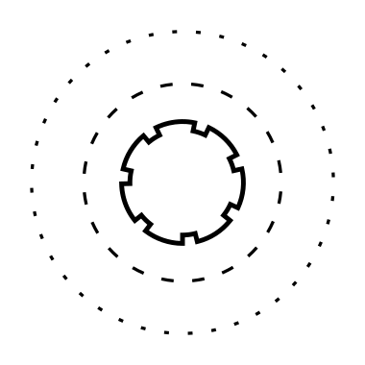

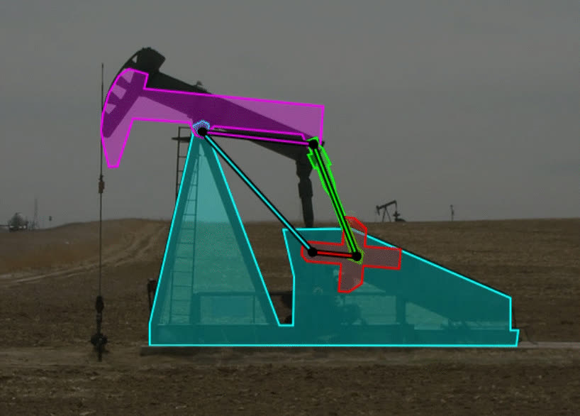
2. Optimizing the Design of Counterbalance
Proper sizing and positioning of the counterbalance to offset the weight of the load, reduces the Energy required from the prime mover.
Use of adjustable counterbalance systems to optimize the balance based on operating conditions.
3. Drive System Efficiency
Select efficient drive systems, such as high-efficiency electric motors, to minimize energy losses during operation.
Use variable frequency drives (VFDs) to match the speed of the prime mover to the load requirements, reducing energy consumption during low-demand periods."

Slide 7
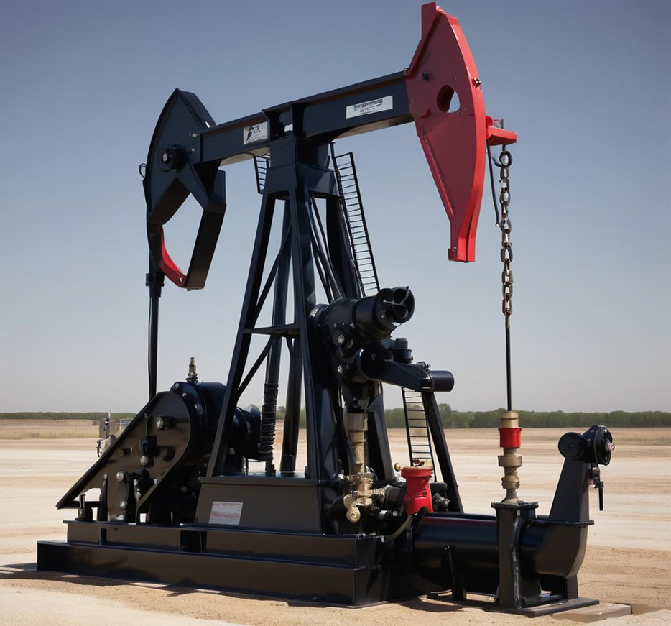
4. Control Systems
The implementation of advanced control systems optimizes the operation of the pump jack based on real-time conditions.
This includes adjusting the stroke length or speed of operation to minimize energy consumption.
Additionally, sensors and automation are used to detect any inefficiencies in the system.

Slide 8
6. Pump Efficiency
Selection of efficient pumps that minimize energy losses, such as positive displacement pumps or efficient centrifugal pumps.
The use of Variable Frequency Drives (VFDs) to control the speed of the pump and optimize energy usage can increase pump efficiency.
7. Maintenance and Monitoring
Regular maintenance of the pump jack components to ensure they are operating efficiently.
Continuous monitoring of energy consumption and performance parameters to identify areas for improvement.

Slide 9

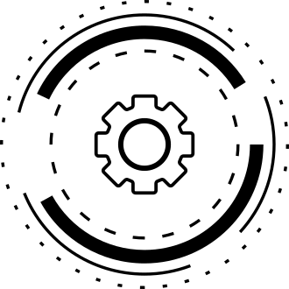
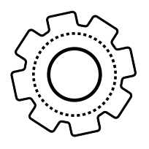
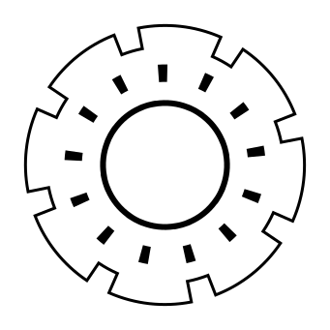
Kinematic & Dynamic Analysis
Assumptions Taken:
The crank is balanced at A due to counter-mass
The crank is rotating CCW with uniform angular velocity, i.e., the angular acceleration of the crank is 0.
The force ‘P’ acts tangential to the horsehead, so it is considered along the Y axis only.

Slide 10
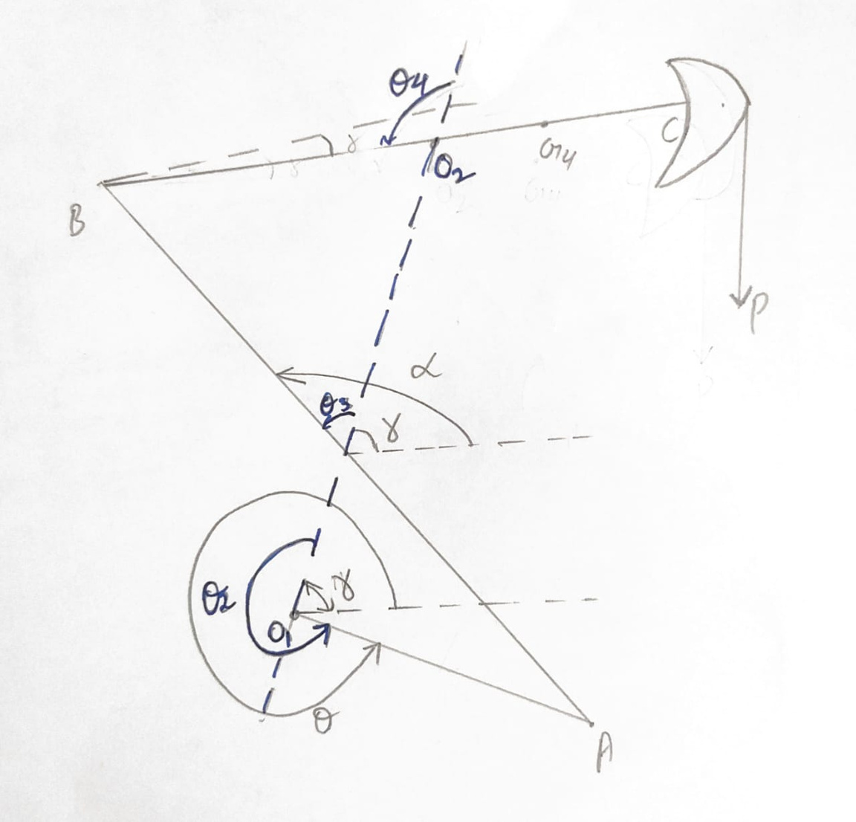



In some cases, angles are measured with respect to fixed length or sometimes with respect to horizontal.
The realtion between the two measurements is also calculated.

Slide 11

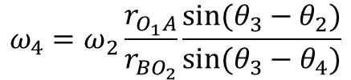


Angular Velocity:
Angular Accelerations:
Accelerations of mass centers:

Slide 12
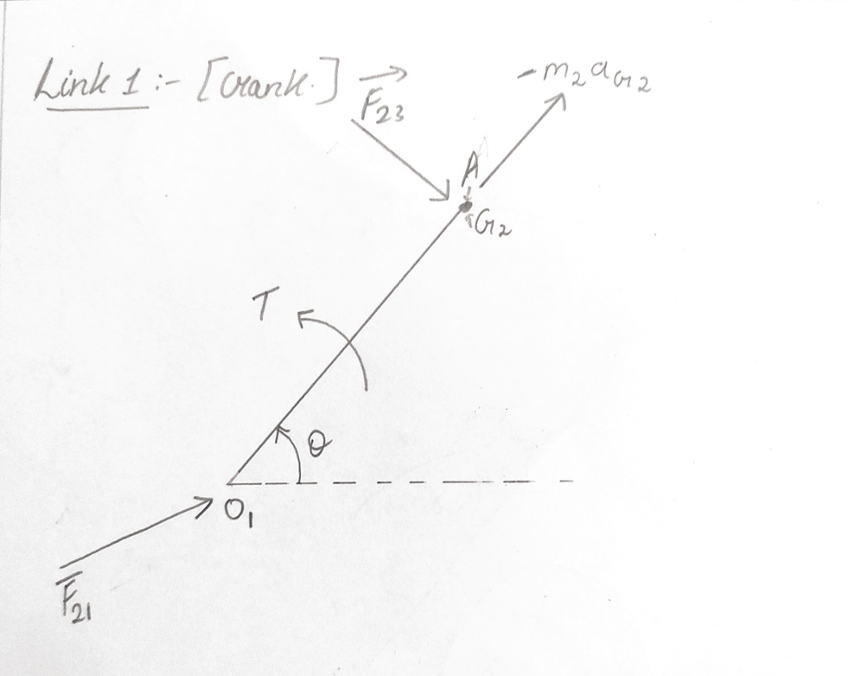


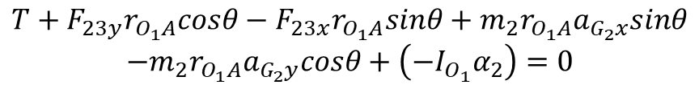
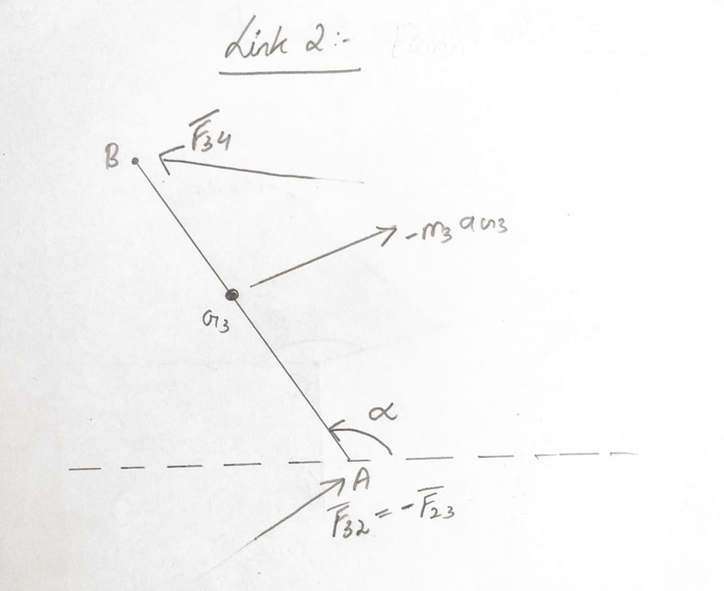


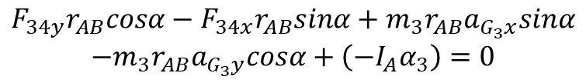

Slide 13
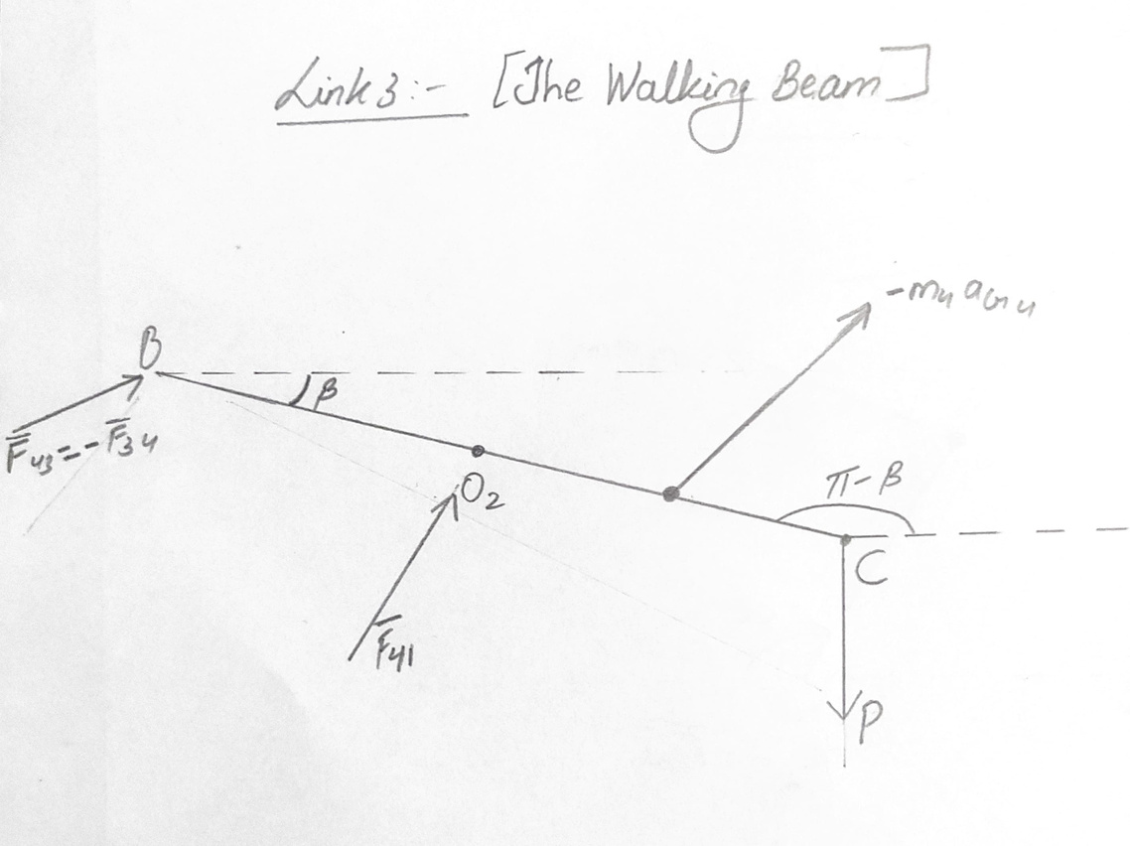


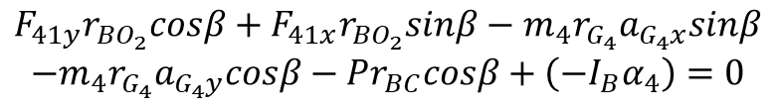
Also the 2 extreme positions occur when the links 01A & AB are in a straight line.

Slide 14
Degree of Freedom:
Firstly we will calculate the degree of freedom of the mechanism. The degree of freedom canbe defined as the number of inputs required to completely define the motion of themechanism. Oil Pump Jack is a four bar mechanism with all full joints. There are no half joints.The mechanism mostly contains the pin joints. The formula used to calculate the mobility or thedegree of freedom is given as:
M = 3(L – 1) – 2J
Where;M = MobilityJ = No. of joints,L = No. of linksIn this mechanism, we have 4 links i.e. crank, rocker, coupler and ground and four joints. Thus;J = 4L = 4Putting in the equation above;
M = 3(4 – 1)– 2(4)
M = 3(3) – 8 = 1M = 1
Grashof motion Analysis:
The link lengths being used can roughly be approximated as :
Crank = Shortest link; Ground = Longest Link
Rocker = Link P Coupler = link Q
The other two links will be longer than crank but smaller than Ground link. According to the
Grashof’s condition;
S + L < P + Q

Slide 15
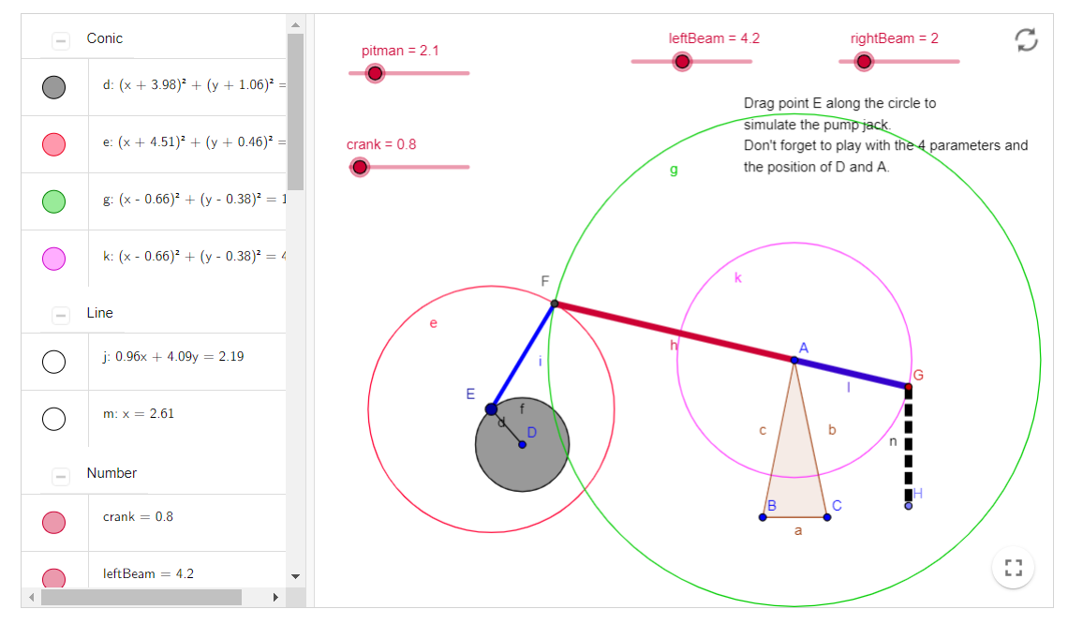
Simulation of pump jack using geogebra

